Slide 1
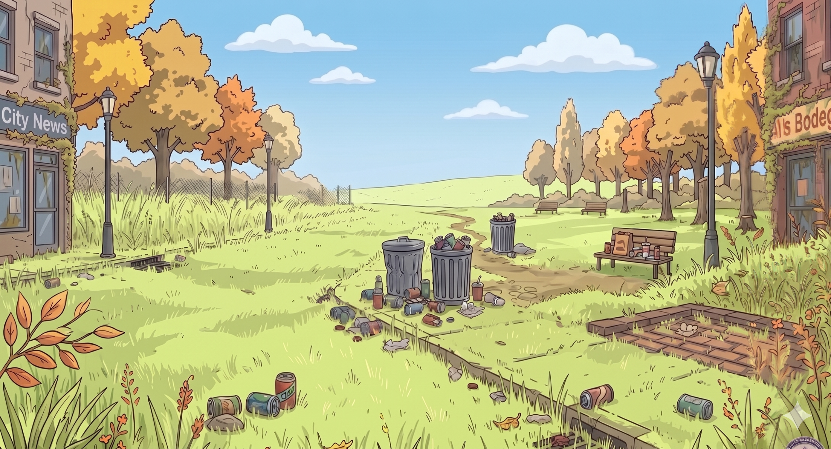
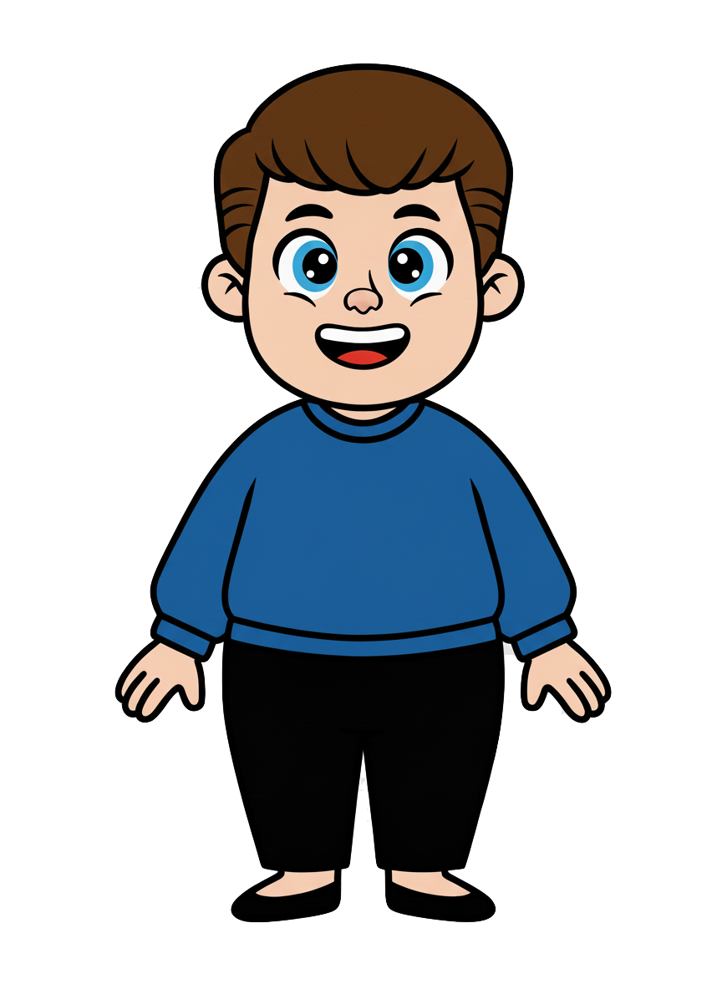
This is Kai.

Slide 2
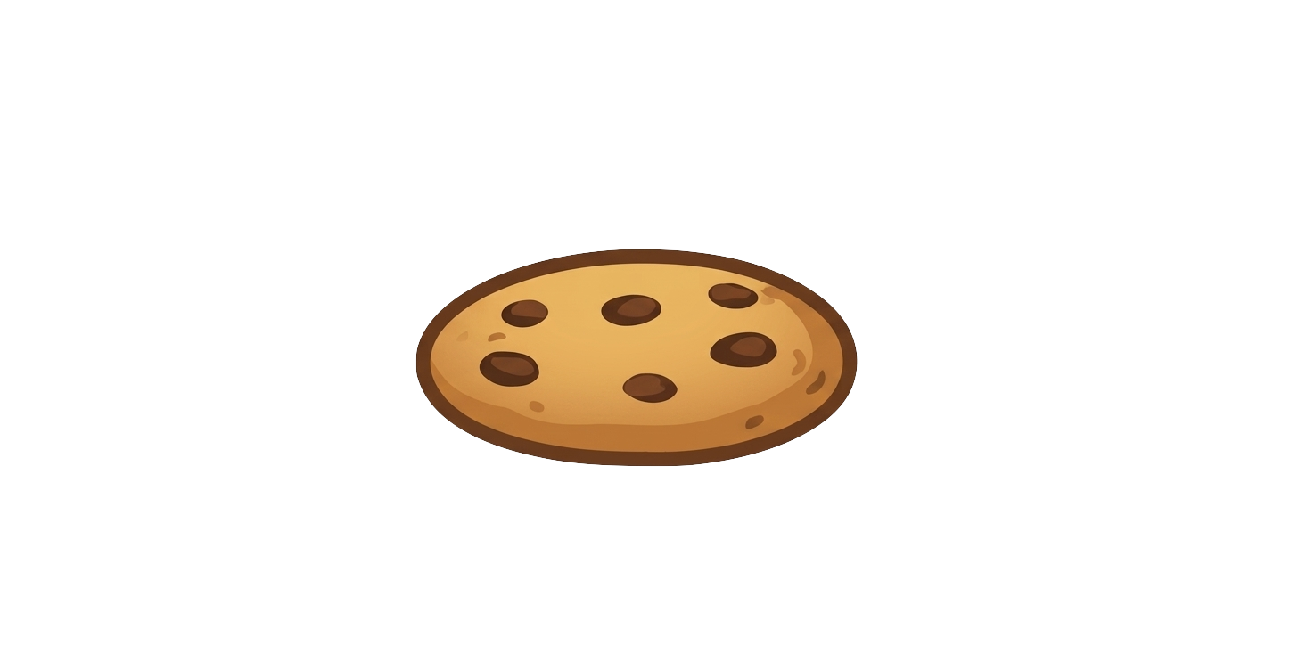
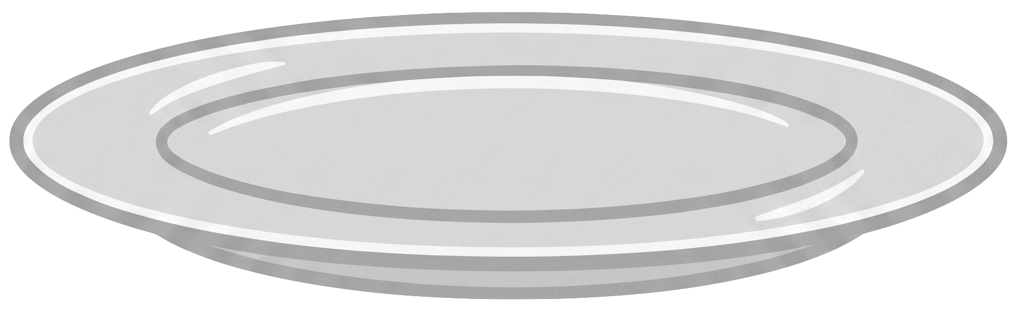
Kai has 7 cookies.

Slide 3
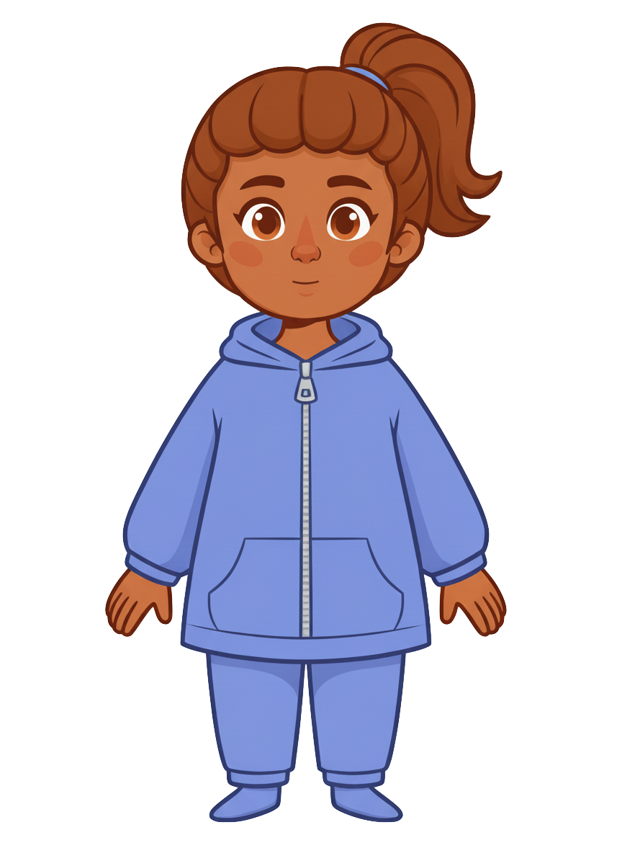
This is Ruby.

Slide 4
Ruby has 2 cookies.

Slide 5
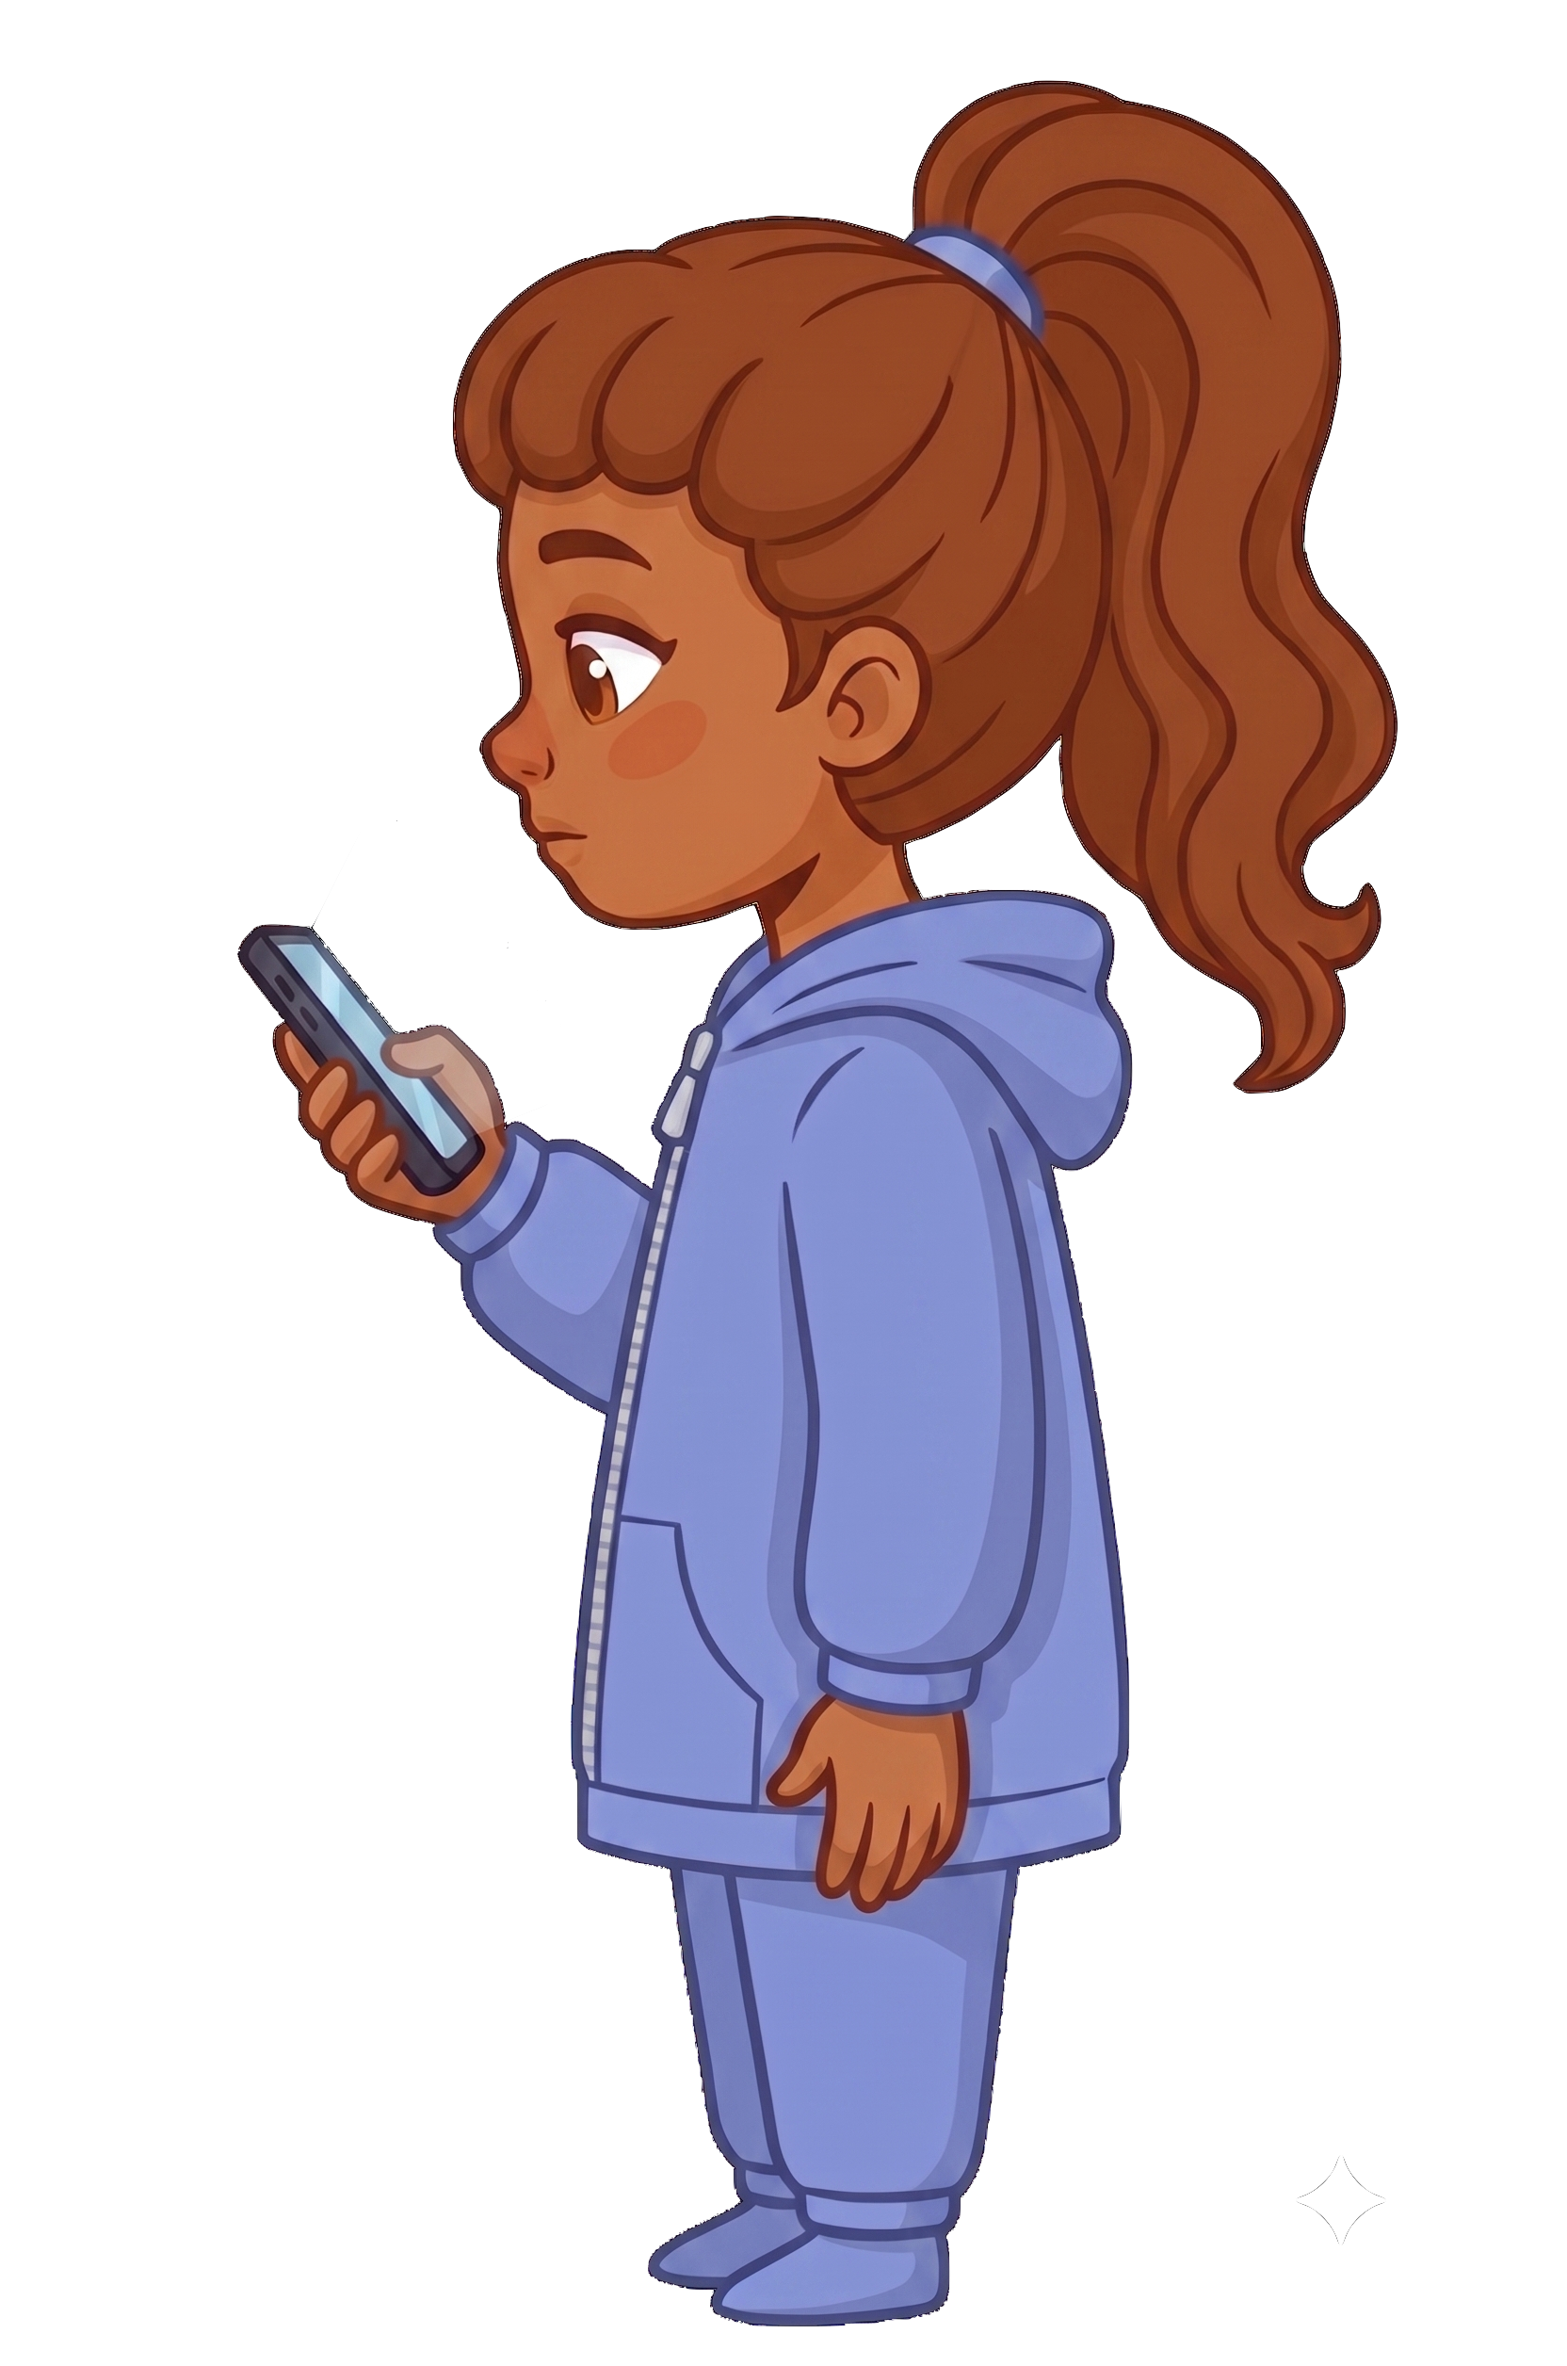
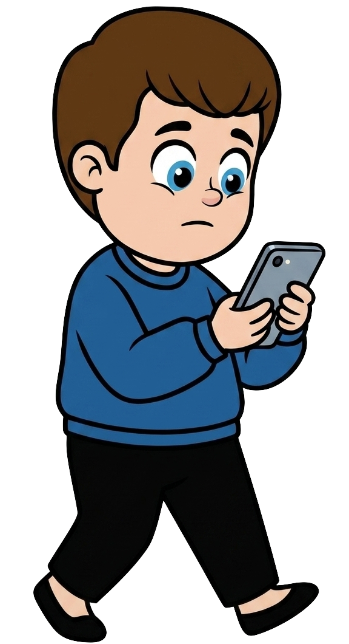
Kai is walking and staring at his phone.

Slide 6
Ruby is also staring at her phone.

Slide 7
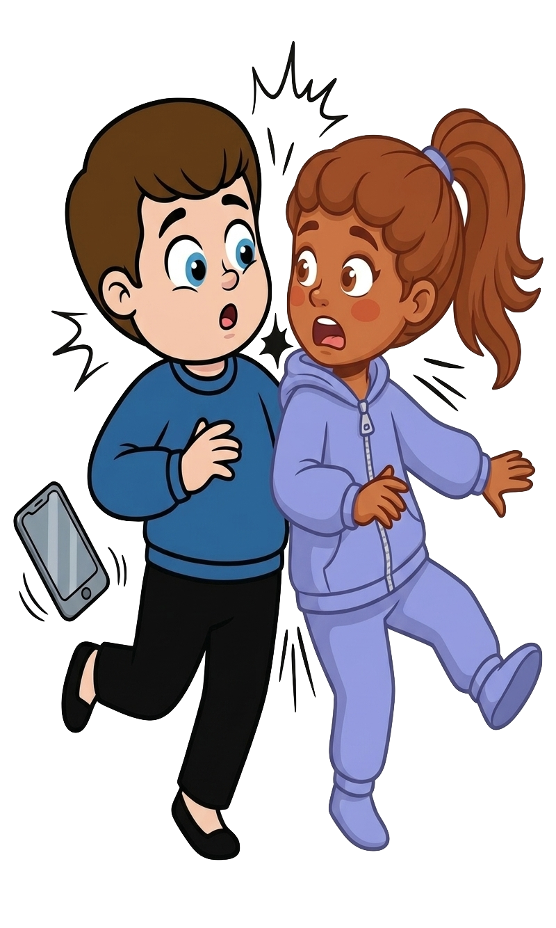
Oh no! Kai bumps into Ruby!

Slide 8
2 of Ruby’s cookies fall!

Slide 9
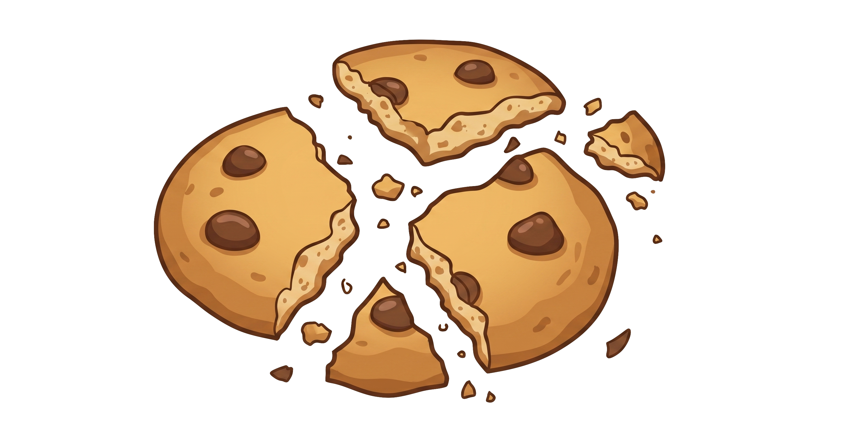
Kai still has 7 cookies. Ruby now has 0 cookies.

